Slide 1
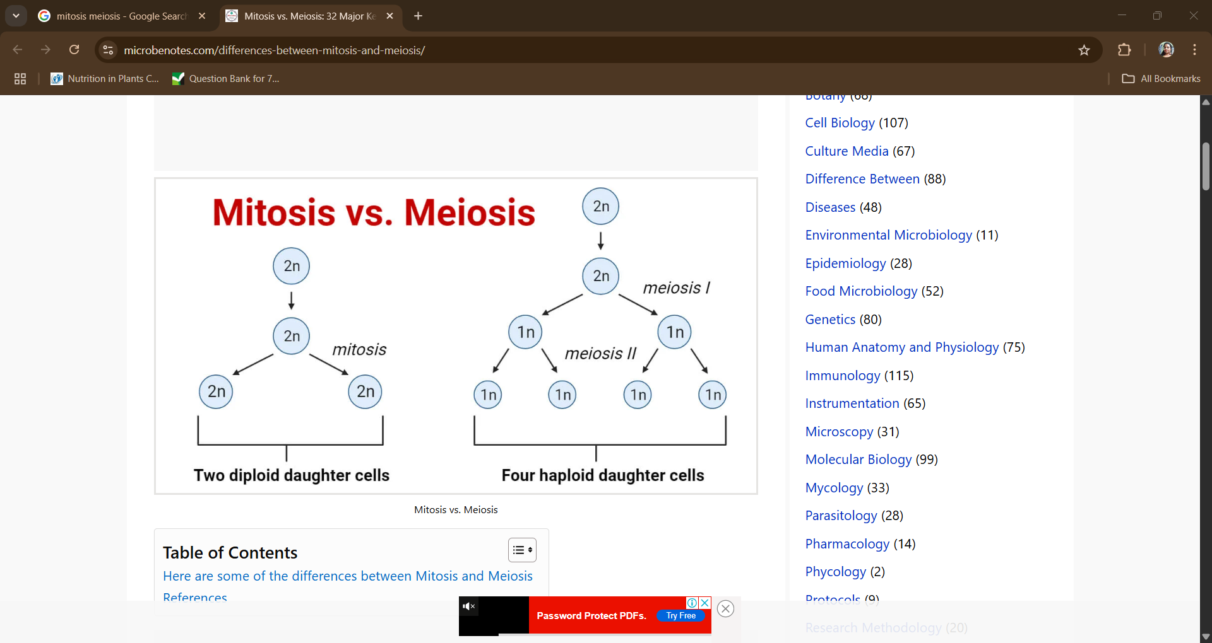
BIOLOGY STUDY MATERIALS
CLASS IX
CELL DIVISION
Human reproduction involves the union of a sperm cell from a male and an egg cell from a female, leading to the formation of a fertilized egg (zygote) that develops into a new individual.

Slide 2
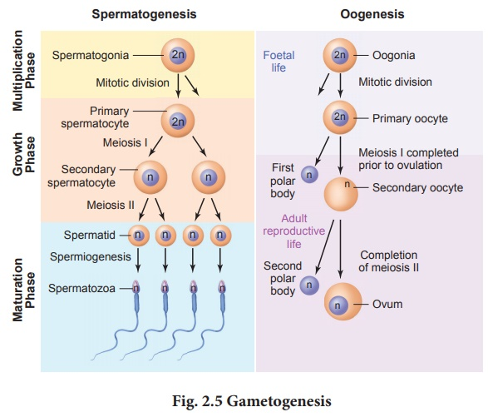
Gametogenesis
Gametogenesis is the process of formation of gametes i.e., sperms and ovary from the primary sex organs in all sexually reproducing organisms.

Slide 3
MENSTRUAL CYCLE
1. Menstrual phase
When you have a period, your uterus lining sheds and flows out of your vagina. Your period contains blood, mucus and some cells from the lining of your uterus. The average length of a period is 3 to 7 days.
2. The follicular phase
The follicular phase starts on the first day of your period and lasts for 13 to 14 days. Changing hormone levels cause the lining of your uterus to thicken and follicles to grow on the surface of the ovaries. Usually only one follicle will mature into an egg.
3. Ovulation
Ovulation is when a mature egg is released from an ovary. This usually happens once a month, about 2 weeks before your next period.
4. The luteal phase
After ovulation, the egg travels through the fallopian tubes to your uterus. The uterus lining continues to thicken in preparation for pregnancy.
If you fall pregnant, you won't have a period. If you don't get pregnant, you'll have a period and the menstrual cycle will start again.
Fertilisation: The process where a male sperm cell fuses with a female egg cell or ovum is called Fertilisation.

Slide 4
REPRODUCTIVE HEALTH
Reproductive health is a state of complete physical, mental and social well-being of an individual and not merely the absence of disease or infirmity, in all matters relating to the reproductive system and to its functions and processes.
Physical wellbeing :
It encompasses the body's ability to function optimally and maintain good health, allowing individuals to perform daily activities and social roles without limitations or undue fatigue. It's a holistic concept encompassing various aspects like -
Physical activity
Nutrition
Sleep
Stress management and health check-ups.

Slide 5
POPULATION CONTROL METHODS
India is currently the most populous country in the world. As of 2025, it has an estimated population of over 1.46 billion.
Population control:
User friendly
No side effects
Easily available
Effective
Birth control:
Traditional method – Avoiding physical meeting of egg and sperm. High chance of failure.
Artificial method

Slide 6
SEXUALLY TRANSMITTED DISEASES (STD)
Alternately named: Reproductive tract infections (RTIs).
High vulnerability/risk group: 15-24 years.
Mode of transmission: Sexual intercourse.
Sr No. | Category | Disease
1 | Protozoan disease | Trichomoniasis
2 | Bacterial Disease | Gonorrhoea, Syphilis, Chlamydiosis
3 | Viral disease | Genital herpes, Hepatitis-B, Genital warts, AIDS.

